Slide 1
Exploring Correlation between LPI & GDP
Saverio Guzzo

Slide 2
Dataset(s)
World Development Indicators Dataset

Slide 3
Motivation
With this project I aimed at exploring the correlation which might exist between the Logistics Performance Index (LPI) and the GDP pro capita of any country.
LPI is an indicator describing the performance of a country across different logistics activities and operations.

Slide 4
Research Question(s)
Is there any correlation between how a country perform on its logistics duties and its GDP pro capita? How strong is the correlation?

Slide 5
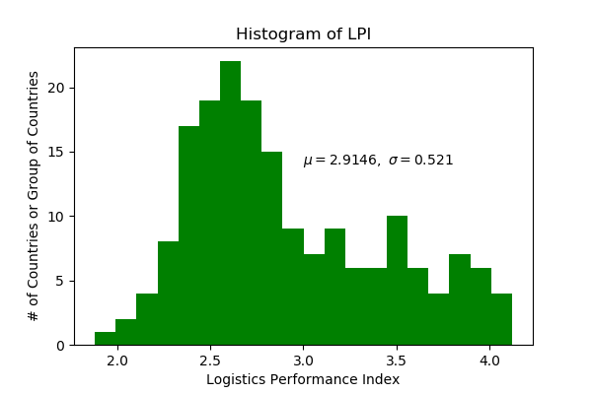
Findings
LPI is a ratio measurements with values spacing from 1 (the least of performance) to 5 (the maximum performance).
Across 181 countries (year 2014), the average has been found equal to 2.9146. With values ranging from Congo’s 1.879 to Germany’s 4.121 and a standard deviation of 0.52

Slide 6
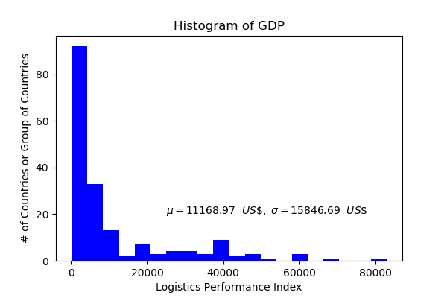
Findings
GDP pro capita (constant 2005 US$) has been found following the distribution in the image. With an average of 11168.97 US$/year

Slide 7
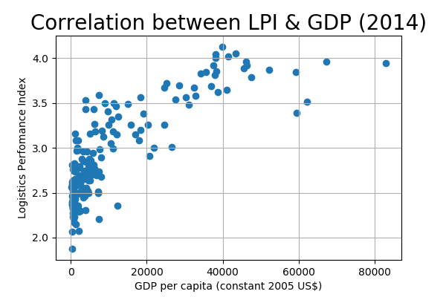
Findings
Plotting LPI and GDP it has been found the relationship represented in the figure.
Correlation Coefficient = 0.811
We might guess a logarithmic relation. Regressing LPI (Y) against GDP (X) the fit curve
Y = 0.276 + 0.627*X has been found throught numpy.polyfit

Slide 8
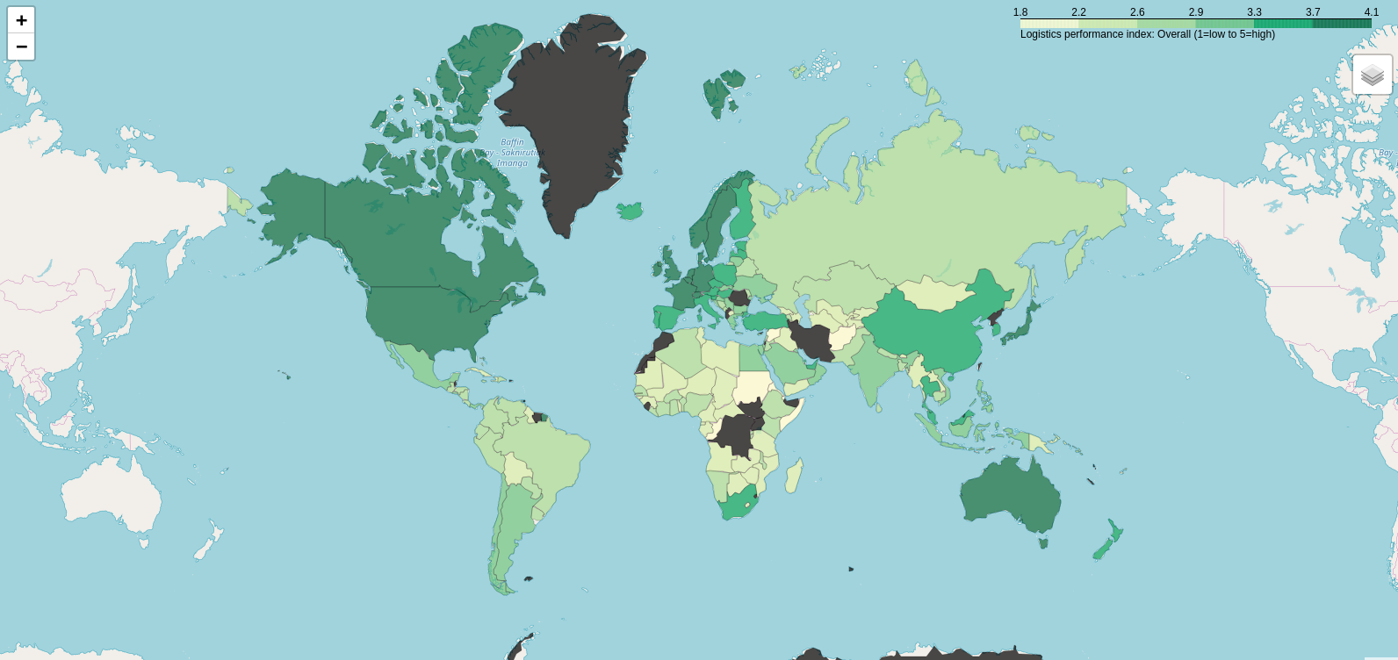
Findings

Slide 9
Acknowledgements
Did you use other informal analysis to inform your work? Did you get feedback on your work by friends or colleagues? Etc.
If you had no one give you feedback, it’s okay to say that.

Slide 10
References
https://lpi.worldbank.org/

